Slide 1



Explainable Vision-Language Diagnostic Assistant for Chest Radiographs
An offline, edge-optimized medical AI solution empowering rural health workers with automated chest X-ray interpretation, visual heatmap reasoning, and priority triage scoring.
Group number: 4 Cluster - 3 Section – 7
Under the Guidance of:
Dr. K .Swanthana
PROJECT GROUP MEMBERS
P. Kavya Sai
P. Meghna
S. Anjana
D. Poojitha
2420030322
2420030401
2420030499
2420030697

Slide 2


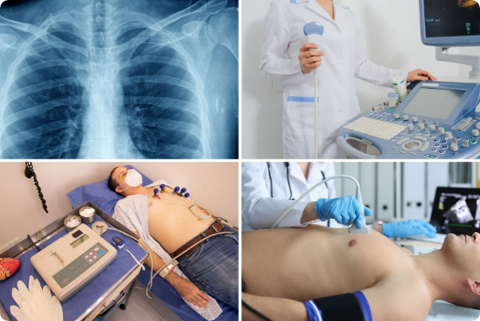
Problem Statement
Acute Radiologist Shortage: Primary health centers in rural regions lack specialist radiologists to read X-rays and detect conditions like pneumonia or tuberculosis.
Diagnostic Delays & Travel Burden: Patients travel vast distances to urban hospitals, delaying time-critical care and incurring heavy financial expense.
.
Black-Box AI Mistrust: Traditional AI systems provide class outputs without explanations, making local nurses reluctant to rely on machine predictions.

Slide 3



Project Objectives
1. Multimodal Diagnosis To develop a vision-language assistant to generate plain-language diagnostic descriptions (e.g., "early signs of pneumonia") alongside class confidence scores.
2. Visual Explanation To incorporate Grad-CAM heatmaps and attention overlays that circle the exact anatomical regions of concern, giving healthcare workers verifiable proof.
3. Automated Triage & Priority Guidance To compute case urgency flags (e.g., "Please refer to specialist within 24 hours") so rural health workers can prioritize critical emergency cases immediately.

Slide 4
Literature Survey & Research Gap
Research Work / Model | Key Contribution | Limitation / Research Gap | Research Paper
ResNet & DenseNet | Strong CNN-based image classification and feature extraction. | Mainly focused on classification; limited report generation and multimodal reasoning. | ResNet Paper / DenseNet Paper
CheXNet | Detects pneumonia and other thoracic diseases from chest X-rays using deep CNNs. | Primarily classification-based and lacks comprehensive multimodal reasoning. | CheXNet Paper
Grad-CAM | Generates heatmaps showing image regions responsible for model predictions. | Visual explanation is not inherently connected to textual diagnosis or clinical reasoning. | Grad-CAM Paper
BLIP-2 | Connects image encoders with large language models for vision-language understanding and generation. | Large language models can still require substantial computational resources. | BLIP-2 Paper
MedKLIP | Incorporates medical knowledge and aligns medical entities with visual image regions for X-ray diagnosis. | More complex architecture and computational requirements make lightweight deployment difficult. | MedKLIP Paper

Slide 5
Literature Survey & Research Gap
Research Work / Model | Key Contribution | Limitation / Research Gap | Research Paper
GLoRIA | Learns global and local image-text representations by associating image regions with words from radiology reports. | Requires paired image-report data and does not directly provide actionable triage recommendations. | GLoRIA Paper
ConVIRT | Uses paired medical images and text for contrastive learning and improves medical image representation with limited labels. | Focuses mainly on representation learning rather than complete diagnosis, explanation and triage. | ConVIRT Paper
MedCLIP | Uses medical knowledge-based contrastive learning with unpaired medical images and text. | Primarily supports representation learning and retrieval/classification rather than report generation and triage. | MedCLIP Paper
ChestX-ray8 / ChestX-ray14 | Provides large-scale chest X-ray datasets for disease classification and weakly supervised localization. | Labels are largely derived from reports and the datasets alone do not provide multimodal clinical reasoning. | ChestX-ray8 Paper
Standalone Saliency Maps | Highlight important regions of medical images to support visual interpretation. | Usually lack textual diagnostic explanation, severity assessment and actionable triage guidance. | Grad-CAM Reference Paper

Slide 6

Innovation, Creativity & Novelty
Dual-Stream VLM Core Combines Vision Transformers (ViT) for spatial feature extraction, CLIP for vision-text alignment, and BLIP-2 for diagnostic report synthesis into a unified framework.
Offline Edge Deployment Pioneers 8-bit quantization on multimodal medical networks, enabling complete offline execution on mid-range Android mobile devices in zero-connectivity posts.
Transparent Reasoning Generates dual Grad-CAM heatmaps and cross-attention overlays on the X-ray scan, bridging the trust gap between automated AI outputs and rural clinical workers.

Slide 7

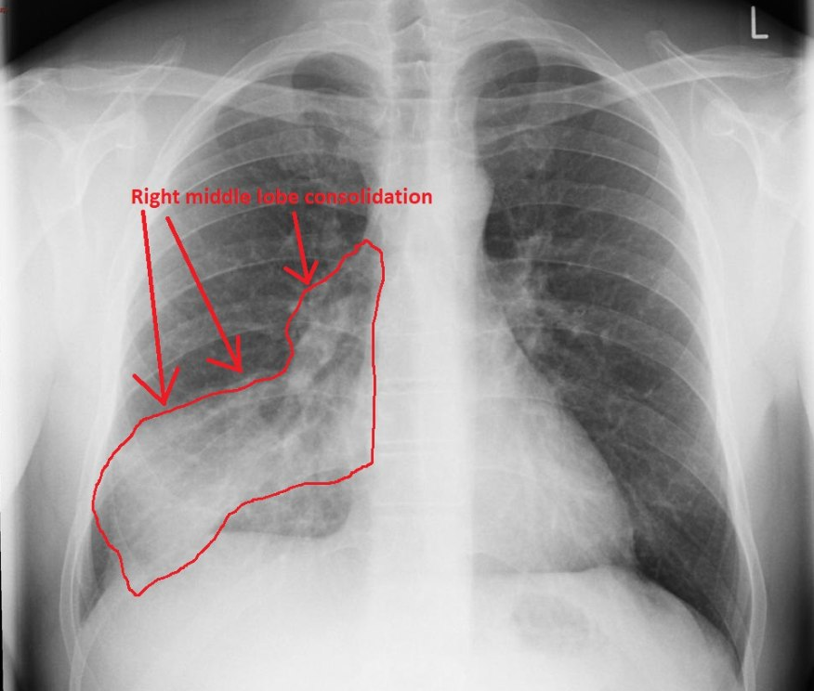
Datasets & Technical Methodology
Training Datasets
Pipeline Flow
Dataset | Resource URL | Key Details
ChestX-ray14 | NIH CC Box | 112,120 chest X-rays with 14 disease labels.
OpenI (OpenAccess) | NLM OpenI | 7,470 X-rays paired with clinical radiology reports.
ROCO Medical | GitHub / ROCO | Multimodal radiology dataset for text-image alignment.
Multi-Source Preprocessing: Normalization & augmentations.
ViT + CLIP Alignment: Encodes spatial features into shared space.
Dual Heads: Disease Classifier + BLIP-2 Natural Text Generator.
Explainability Layer: Grad-CAM heatmaps & attention maps.
Android Runtime: Quantized model providing offline triage.

Slide 8
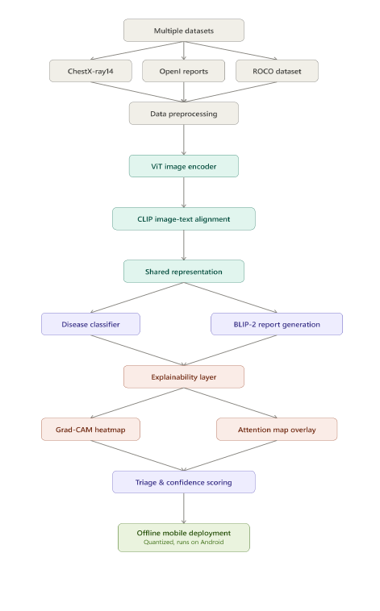
Flowchart

Slide 9



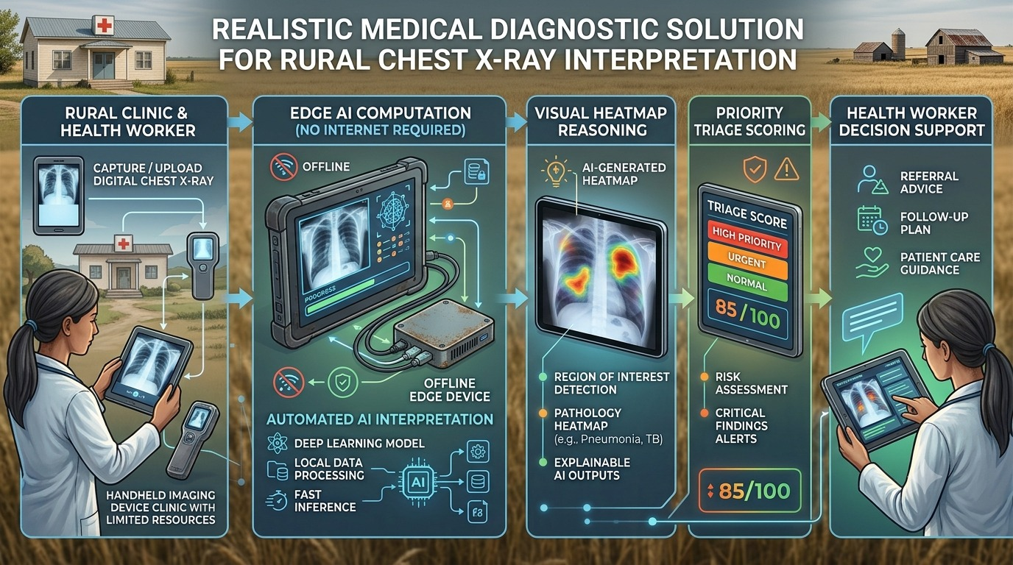
Project Plan & Evaluation Strategy
PHASE 1
PHASE 2
PHASE 3
PHASE 4
Data Prep & Alignment
Model & Explainability
Optimization & Mobile
Evaluation & Presentation
•
Dataset curation (NIH, OpenI, ROCO)
•
ViT encoder & BLIP-2 report integration
•
INT8 model quantization
•
Metrics: Accuracy, Precision, Recall, F1
•
Data preprocessing & normalization
•
ONNX / Android runtime integration
•
CLIP vision-text alignment tuning
•
Grad-CAM heatmap layer development
•
Offline mobile performance testing
•
Heatmap localization verification
•
Attention overlay generation

Slide 10
THANK YOU!
Our project aims to bridge the rural diagnostic gap by delivering an honest, explainable, and fully offline AI assistant — ensuring patients receive timely and safe care regardless of geographic limitations.

